Slide 1
Project Presentation of Industry Oriented Hands on Experience (22CS422)
On
<SOC Dashboard & Analyst Workflow>
Tarnveer Singh Mann (2210992456)
Yuvraj Singh (2210990989)
Supervised By
Dr. PK Khosla
Dr. Sonam Mittal
Dr. Simarjit Kaur
Department of Computer Science and Engineering,
Chitkara University, Punjab

Slide 2
Introduction
A Security Operations Center (SOC) is essential for monitoring, detecting, and responding to cyber threats in real time. This project presents a lightweight SOC Dashboard built using OpenSearch to centralize log monitoring, detect suspicious activities, and assist security analysts in incident investigation. The system integrates interactive dashboards, automated alert generation, and MITRE ATT&CK-based threat mapping to improve visibility and security analysis. It also supports attack simulation and event correlation, providing a scalable and practical solution for cybersecurity monitoring and research.
Key Points
Centralized security log monitoring
Real-time threat detection and alerting
MITRE ATT&CK framework integration
Interactive dashboards for SOC analysts
Attack simulation and investigation support
Lightweight and scalable architecture
2

Slide 3
Objective
The main objective of this project is to design and develop a lightweight Security Operations Center (SOC) dashboard that enables centralized security monitoring, real-time threat detection, and efficient incident investigation. The system collects and processes security logs from multiple sources, analyzes suspicious activities using detection rules, and visualizes threats through interactive dashboards integrated with the MITRE ATT&CK framework. The project aims to improve the ability of security analysts to detect, investigate, and respond to cyber threats quickly and effectively while providing a scalable and practical platform for cybersecurity monitoring and research.
Key Objectives
Centralize security log collection and monitoring
Detect suspicious and malicious activities in real time
Integrate MITRE ATT&CK framework for threat mapping
Generate automated alerts for detected threats
Provide interactive dashboards for SOC analysts
Support attack simulation and incident investigation
Enable efficient event correlation and timeline analysis
Build a lightweight and scalable SOC solution using OpenSearch
Improve visibility into security events and attack patterns
Create a practical platform for cybersecurity learning and research

Slide 4
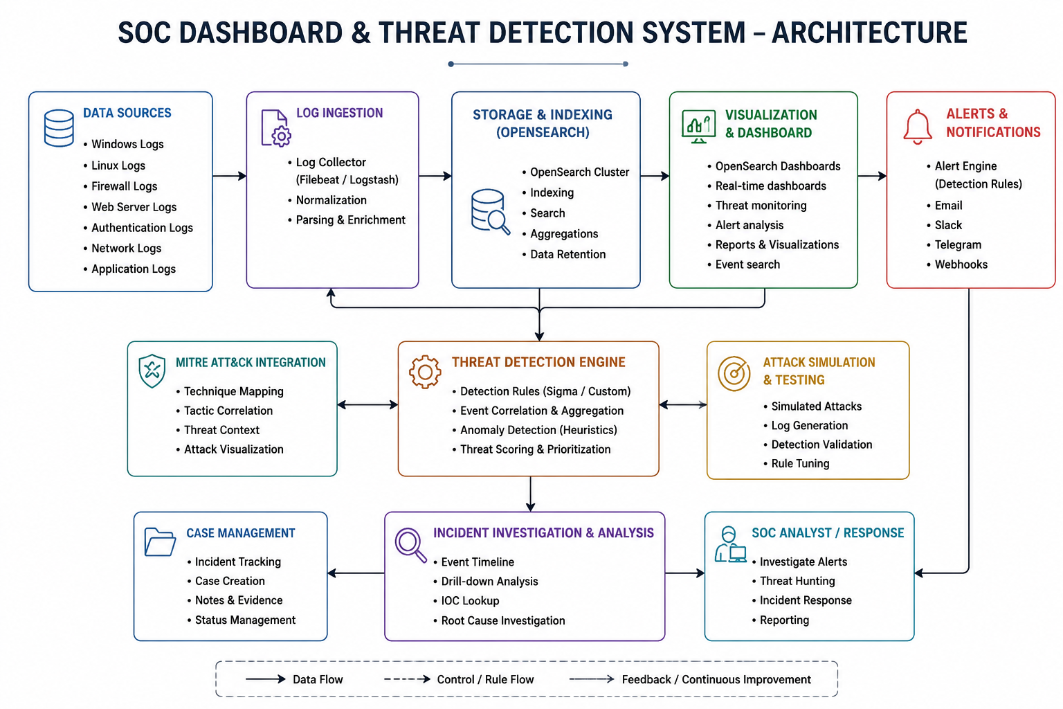
System Architecture

Slide 5
Methodology
1. Requirement Analysis
Identified the need for centralized security monitoring and threat detection.
Studied SOC workflows, SIEM concepts, and MITRE ATT&CK techniques.
Defined system objectives such as log collection, detection, visualization, and alerting.
2. System Design
Designed the architecture of the SOC Dashboard system.
Planned modules for:
Log collection
Data storage
Threat detection
Dashboard visualization
Alert notification
Selected OpenSearch as the core analytics and visualization platform.

Slide 6
Methodology
3. Log Generation & Collection
Generated realistic security logs including:
Authentication logs
Firewall logs
Network logs
Web server logs
Application logs
Used Filebeat/Logstash for log ingestion and normalization.
4. Data Processing & Storage
Processed and parsed logs into structured format.
Indexed logs into OpenSearch cluster for fast querying and analysis.
Applied enrichment and normalization for better correlation.

Slide 7
Methodology
5. Threat Detection Engine
Developed rule-based detection mechanisms using Sigma/custom rules.
Implemented:
Event correlation
Suspicious activity detection
Alert generation
Basic anomaly detection
Integrated MITRE ATT&CK mapping for attack classification.
6. Dashboard Development
Built interactive dashboards using OpenSearch Dashboards.
Visualized:
Alert severity
Attack trends
Threat timelines
Event statistics
MITRE ATT&CK coverage

Slide 8
Methodology
7. Alerting & Notifications
Configured automated alerts for detected threats.
Supported notification channels such as:
Email
Slack
Telegram
Webhooks
8. Testing & Attack Simulation
Simulated attack scenarios to validate detection rules.
Tested:
Brute-force attacks
Suspicious login attempts
Malicious process execution
Network anomalies
Verified alert generation and dashboard updates.

Slide 9
Methodology
9. Analysis & Evaluation
Evaluated system performance based on:
Detection accuracy
Alert generation
Dashboard responsiveness
Log indexing efficiency
Analyzed attack visibility and incident investigation workflow.
10. Deployment & Future Enhancements
Deployed the platform using Docker-based infrastructure.
Proposed future improvements:
Machine learning-based anomaly detection
SOAR integration
Real-time streaming analytics
Threat intelligence integration
Cloud deployment support

Slide 10
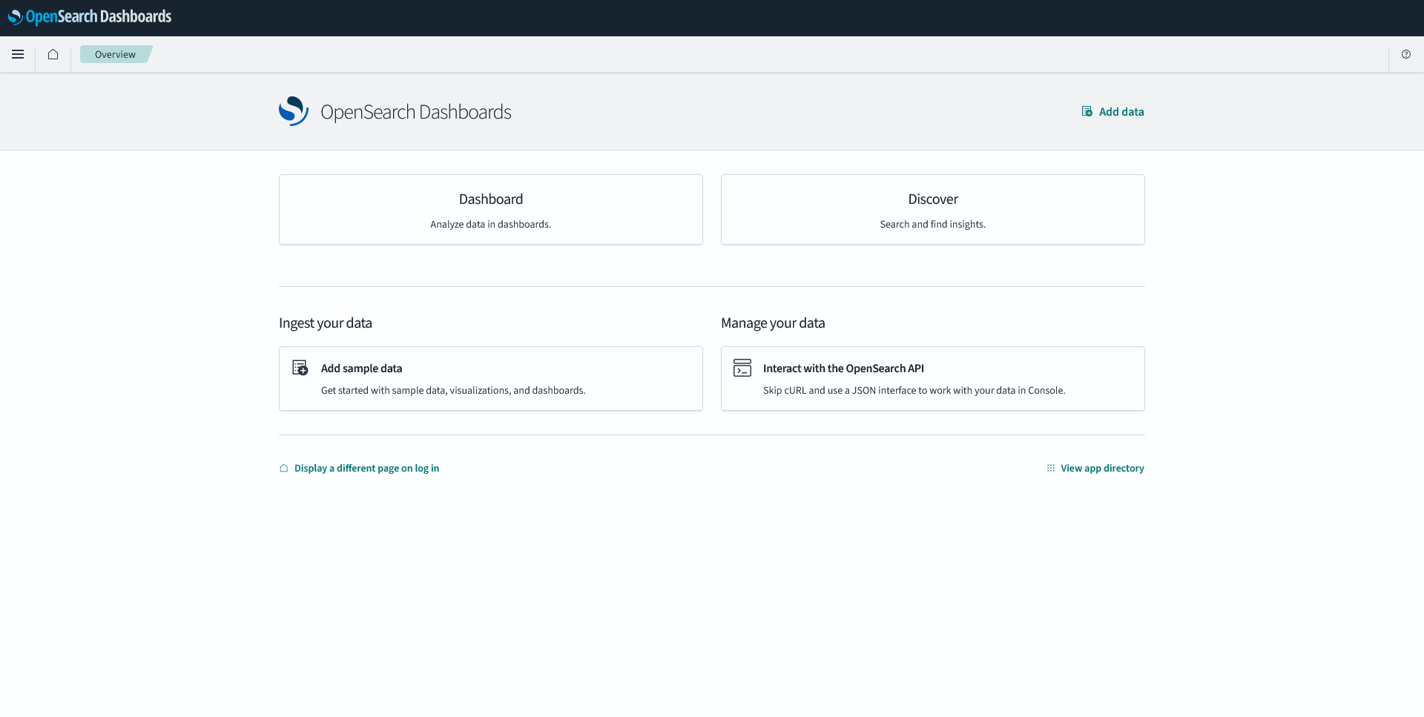
Screenshots
Overview Page

Slide 11
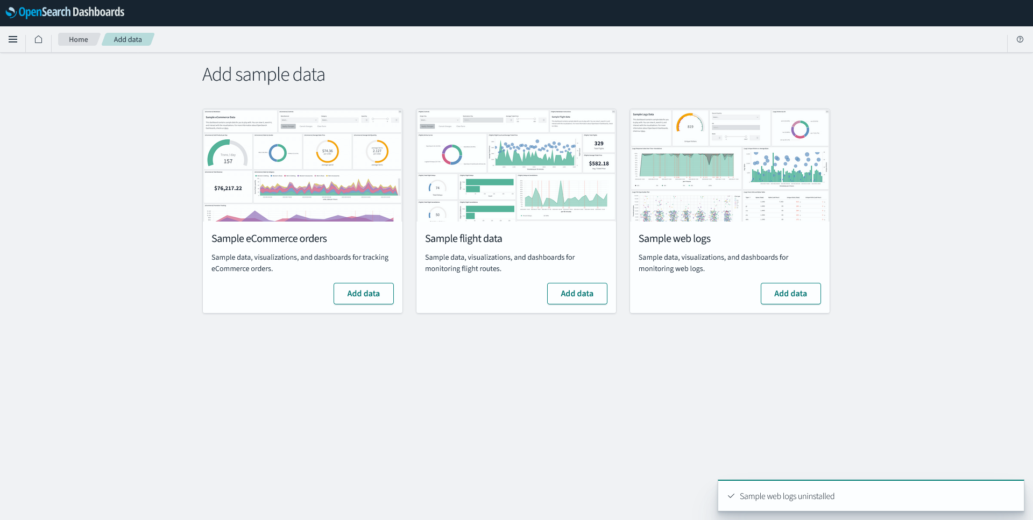
Screenshots
Data selection Page

Slide 12
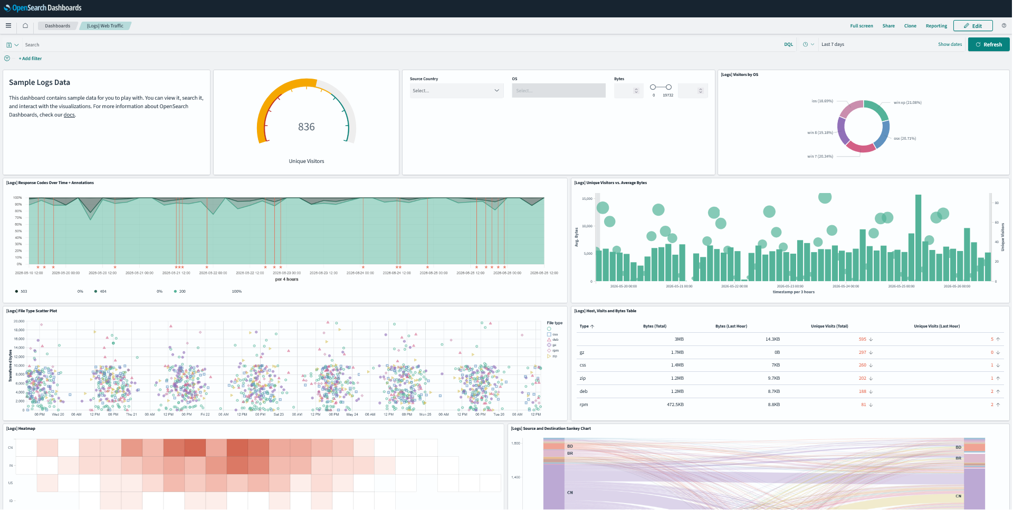
Screenshots
Selected Data Page

Slide 13
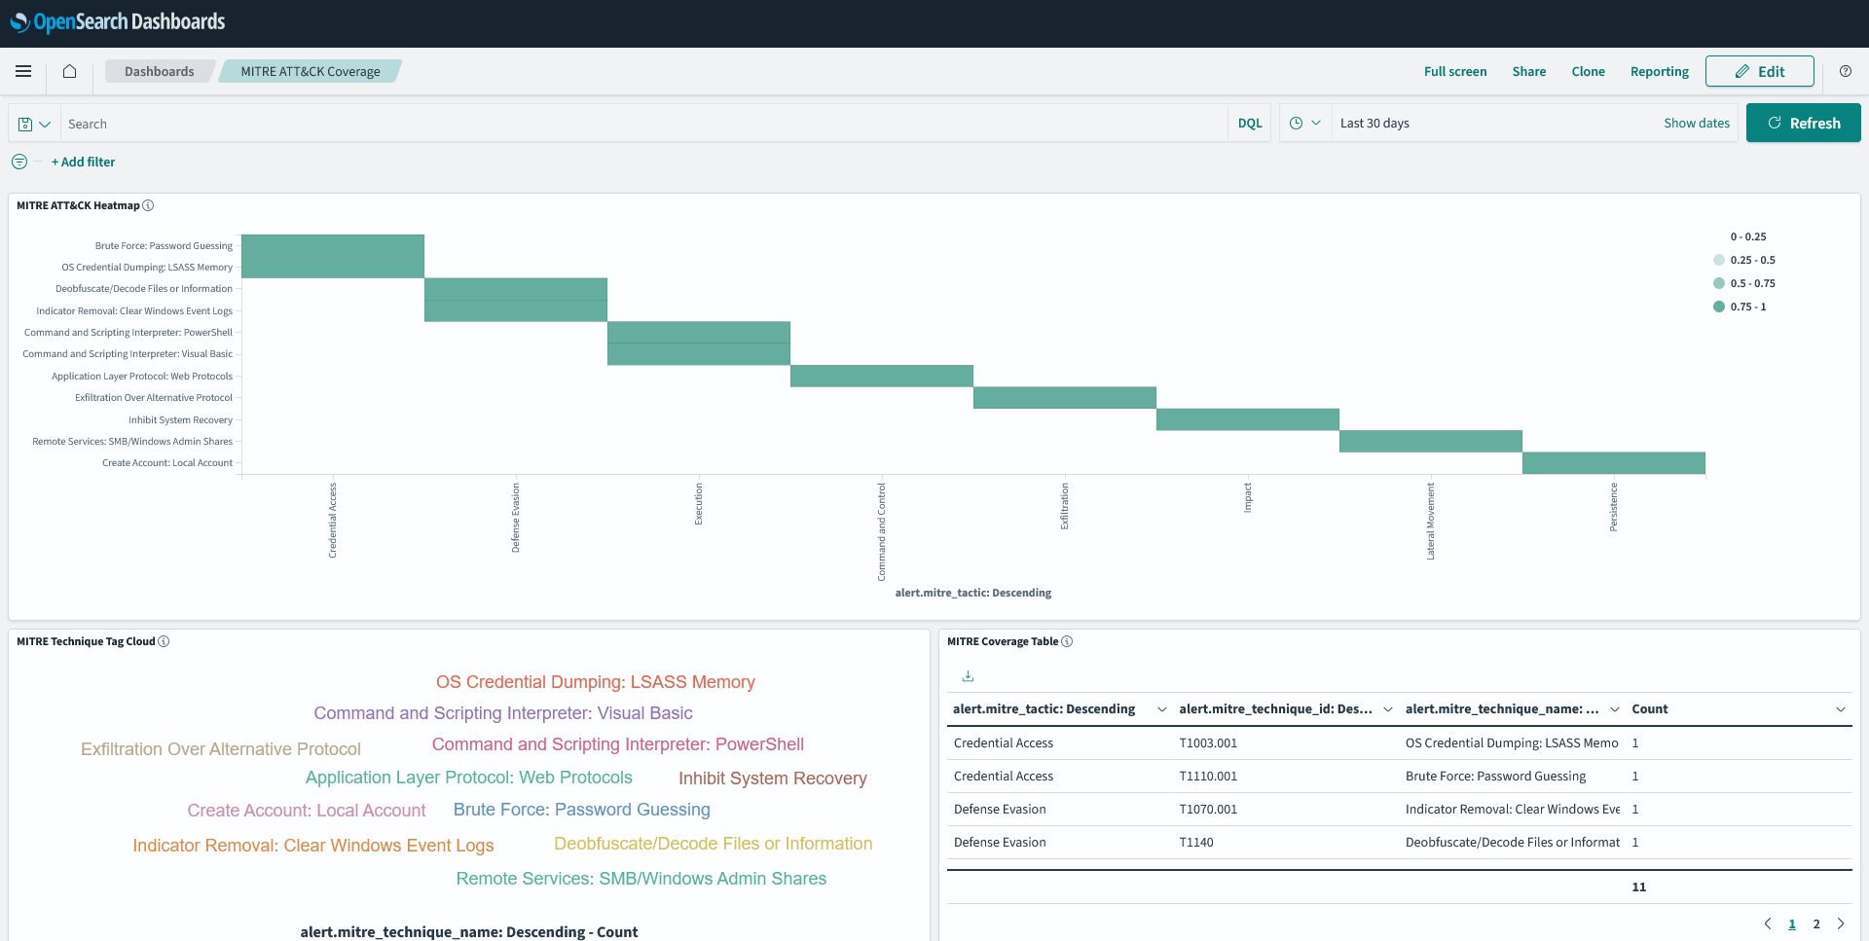
Screenshots
MITRE ATT&&CK Coverage Page

Slide 14
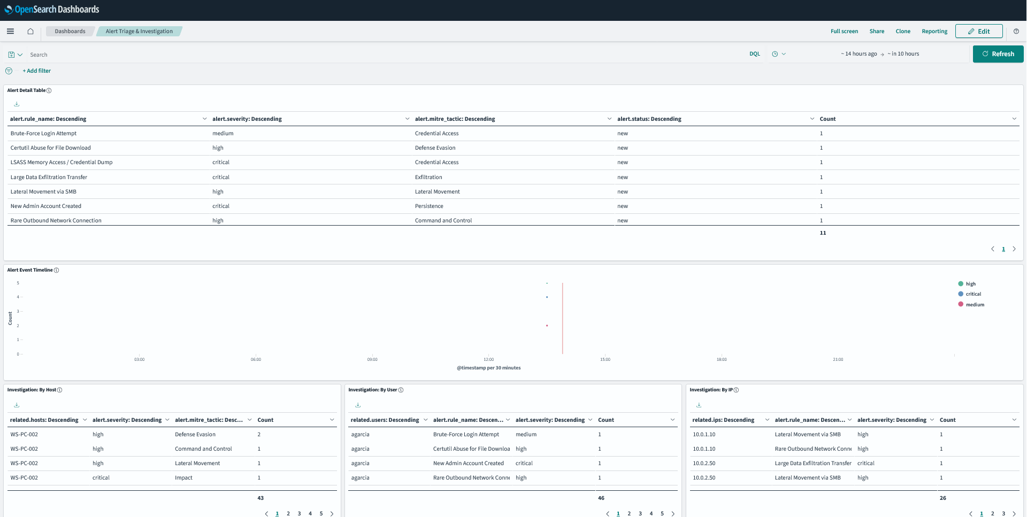
Screenshots
Alert Triage and investigation Page

Slide 15
Future Scope
The future scope of this project focuses on enhancing the SOC Dashboard with advanced automation, intelligent threat analysis, and large-scale deployment capabilities. The system can be extended to support machine learning-based anomaly detection for identifying unknown threats and unusual behavior patterns. Integration with real-time threat intelligence feeds can improve attack detection accuracy by correlating logs with known Indicators of Compromise (IOCs). The platform can also be expanded into a full SIEM and SOAR solution with automated incident response and remediation workflows.
Key Future Enhancements
Machine learning-based anomaly detection
SOAR (Security Orchestration, Automation & Response) integration
Real-time streaming log analytics
Threat intelligence feed integration
Cloud-native and distributed deployment support
AI-assisted threat hunting and investigation
Advanced attack correlation and prediction
Automated incident response workflows
Enhanced visualization and reporting dashboards

Slide 16
Conclusion
The SOC Dashboard & Threat Detection System successfully demonstrates a lightweight and scalable approach for centralized cybersecurity monitoring, threat detection, and incident investigation. By integrating log collection, real-time analysis, automated alert generation, and interactive visualizations using OpenSearch, the system improves the ability of security analysts to identify and respond to cyber threats efficiently.
The project also incorporates MITRE ATT&CK-based threat mapping and attack simulation techniques to provide better visibility into attack patterns and security events. Through dashboard-driven monitoring and rule-based detection, the platform offers a practical solution for cybersecurity research, learning, and real-world SOC operations.
Overall, the project highlights the importance of centralized security analytics and demonstrates how modern SOC workflows can be implemented using open-source technologies in a cost-effective and extensible manner.

Slide 17
Thank You
17

